Slide 1


Android Lecture #
3week
Bitmap Button &
ListView

Slide 2

Contents
Bitmap Button
Property of Bitmap Button
Example
Usage of Camera
Use of Camera
Example

Slide 3

Bitmap Button

Slide 4

1. Bitmap Button
ImageView cannot check click
See the change from click -> Bitmap Button
For use of Bitmap Button, make a new View inheritance from android View.

Slide 5
2. Property of Bitmap Button
onMeasure : to parent container, allocate maximum height and width
In this case, View change size itself
onDraw : show 2D graphics

Slide 6
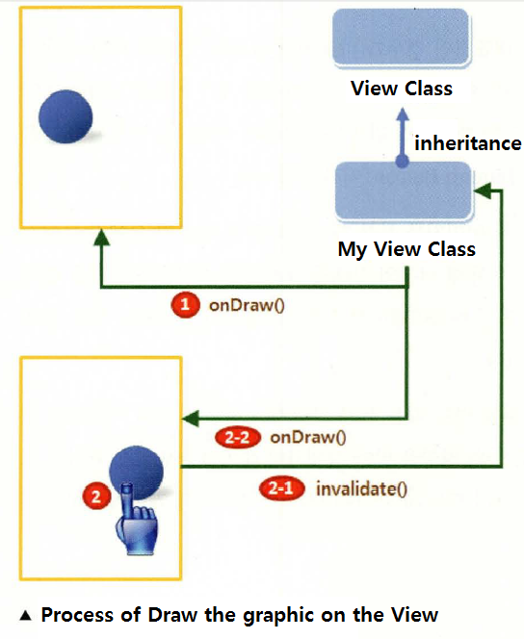
2. Property of Bitmap Button

Slide 7
Before Example
ACTION_DOWN : Screen is clicked express constant
ACTION_MOVE : Something is moving on screen express constant
ACTION_UP : Something is disappear which clicked your screen express constant

Slide 8
Before Example
setContentView() : set all screen of activity
LayoutInflater : Not for all screen, but for part of View.
If we use layoutinflater, set on memory.
In specific View, if we want to call View, then we can to use layoutinflater.
Developer can change the property of something and when to show, or other things.

Slide 9
3. Example
SampleBitmapButton

Slide 10
Camera

Slide 11
1. Usage of Camera
Picture
Barcode or QR code

Slide 12
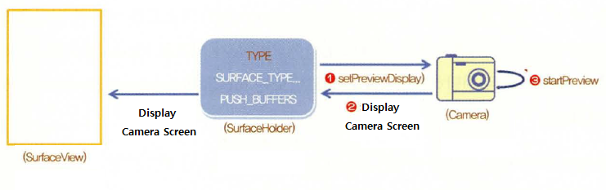
2. Use of Camera

Slide 13
3. Example
SampleCapture

Slide 14
Thank you!

